Slide 1
... Lecture 6 ... Single Locus Models

Slide 2
... Lecture 6 ... Single Locus Models
Part 1: estimating effects of loci

Slide 3
Genetic Variation in Models
Sources with ‘random effect’
infinitesimal model within breeds
many loci within breeds i.e. approximate
a set of inbred lines derived from a base
a large sample of breeds (possibly)
Sources with fixed effect
differences between breeds or named lines
unlikely to be a randomly sampled
specific pre-determined loci

Slide 4
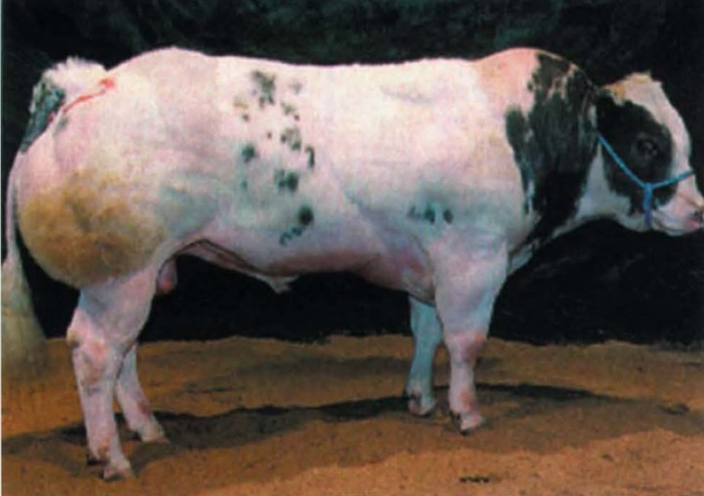
Myostatin Gene
Causes double muscling in cattle
One of the first causative variants identified for a complex trait
is it in other populations?
Nature Genetics 17: 71-74

Slide 5
Myostatin Gene
Causes double muscling in cattle
One of the first causative variants identified for a complex trait
is it in other populations?
YES!
does it have the same effect?
Nature Genetics 17: 71-74

Slide 6
Myostatin Gene
Causes double muscling in cattle
One of the first causative variants identified for a complex trait
is it in other populations?
YES!
does it have the same effect?
NO!
Nature Genetics 17: 71-74

Slide 7
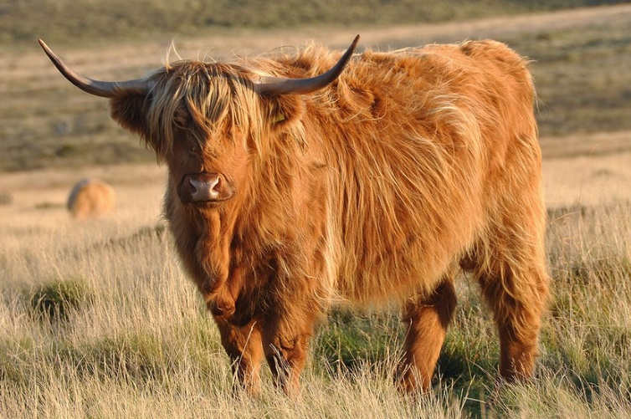
Myostatin Gene
Causes double muscling in cattle
One of the first causative variants identified for a complex trait
is it in other populations?
YES!
does it have the same effect?
NO!
Nature Genetics 17: 71-74
from Wikipedia

Slide 8
Myostatin Gene
Causes double muscling in cattle
One of the first causative variants identified for a complex trait
is it in other populations?
YES!
does it have the same effect?
NO!
is it pleiotropic?
YES!
Nature Genetics 17: 71-74
from Wikipedia

Slide 9
Test Effects
Natural experiment to look at these questions
sample population
measure traits of interest
genotype the locus
fit a model

Slide 10
Least Squares Model
Model y = 1m + X₁b + X₂g + e
y vector of observations (n x 1)
1m m is mean effect, fixed (1 d.f.)
design vector 1 is (n x 1) vector of 1’s
b nuisance effects, (fixed) with design X₁
g QTL locus, fixed with design X₂ (2 d.f.)
e (n x 1) vector of residual effects
e random, assumed MVN(0,σ_{E}²I)
n … number of observations

Slide 11
Least Squares Model
Model y = 1m + X₁b + X₂g + e
y vector of observations (n x 1)
1m m is mean effect, fixed (1 d.f.)
design vector 1 is (n x 1) vector of 1’s
b nuisance effects, (fixed) with design X₁
g QTL locus, fixed with design X₂ (2 d.f.)
e (n x 1) vector of residual effects
e random, assumed MVN(0,σ_{E}²I)
This is wrong!

Slide 12
Complex Traits
For a complex trait one must expect multiple loci with effects
If this is neglected, only way to explain genetic change is the identified locus
bias the estimated effect
particularly if change is caused by selection

Slide 13
Polygenic Variance
Need to account for other genetic variation
plus any selection
Introduce a polygenic effect
typically assumed to be ‘polygenic’
many alleles of small effect
modelled by random effects
Paper showing bias and polygenic correction
Kennedy, Quinton & van Arendonk
J. Anim. Sci. 1992, 70: 2000-2012

Slide 14
Polygenic Model
Model y = 1m + X₁b + X₂g + Zu + e
y vector of observations (n x1)
1m m is mean effect, fixed (1 d.f.)
design vector 1 is (n x1) vector of 1’s
b nuisance effects, fixed with design X₁
g QTL locus, fixed (2 d.f.) with design X₂
u (p x1) vector of polygenic breeding values
design matrix Z, u random MVN(0,σ_{A}²A)
e (n x1) vector of residual effects,
e assumed random MVN(0,σ_{E}²I)

Slide 15
Polygenic Model
Model y = 1m + X₁b + X₂g + Zu + e
y vector of observations (n x1)
1m m is mean effect, fixed (1 d.f.)
design vector 1 is (n x1) vector of 1’s
b nuisance effects, fixed with design X₁
g QTL locus, fixed (2 d.f.) with design X₂
u (p x1) vector of polygenic breeding values
design matrix Z, u random MVN(0,σ_{A}²A)
e (n x1) vector of residual effects,
e assumed random MVN(0,σ_{E}²I)
p … number in pedigree

Slide 17
Case 1: No Effect of Locus
Ignoring polygenic effects gives too many significant effects
↑ Type I error
problems increase with selection
due to poor estimate of σ_{e}² through not accounting for relationships when σ_{A}² >0
Model with polygenic term shows no increase in Type I error

Slide 18
Case 2: Locus With Effect
Without polygenes, with selection
a biased upward across generation analyses
all selection response being explained by QTL!
a biased downward within generation analyses
due to negative linkage disequilibrium
individuals with poor QTL alleles tend to have good polygenes and vice versa
d has bias, but less
Model with polygenic term is unbiased

Slide 19
Case 2: Locus with Effect
Without polygenes, without selection
potential disequilibrium causing bias
s.e. is underestimated
due to poor estimate of σ_{e}² through not accounting for relationships when σ_{A}² >0
Model with polygenic term removes problems

Slide 20
Conclusion
Models must account for polygenic variation in complex traits
control Type I error
avoid bias in estimates, particularly a
Bias without polygenic term increase with
higher selection intensity
number of generations
i.e. total selection differential applied
Reference Kennedy, Quinton & Van Arendonk, 1992

Slide 22
Fitting Model
Use REML because polygenic σ_{A}² unknown
Use Wald-tests (or t-tests for 1 d.f).
t-test is ‘estimate’/‘estimated s.e.’ for Normal
Wald tests generalise this and use
always approximate, but asymptotically OK
ASReml does it for you!
Use ‘qgm_fixed_linear()’ to estimate contrasts

Slide 23
Genetic Interpretation
For an A/T polymorphism
Fitting 2 d.f. for QTL
test H₀: g_{AA} = g_{AT} = g_{TT} vs H₁: not H₀
Wald test of genotype means

Slide 24
Genetic Interpretation
Estimate contrasts
a = ½ (g_{TT} – g_{AA})
contrast (-0.5, 0.0, 0.5) of g_{AA}, g_{AT}, g_{TT}
‘additive effect’ of T allele

Slide 25
Genetic Interpretation
Estimate contrasts
a = ½ (g_{TT} – g_{AA})
contrast (-0.5, 0.0, 0.5) of g_{AA}, g_{AT}, g_{TT}
d = g_{AT} – ½ (g_{AA} + g_{TT})
contrast (-0.5, 1.0, -0.5)
‘dominance deviation’

Slide 26
Genetic Interpretation
Estimate
a = ½ (g_{TT} – g_{AA})
contrast (-0.5, 0.0, 0.5) of g_{AA}, g_{AT}, g_{TT}
d = g_{AT} – ½ (g_{AA} + g_{TT})
contrast (-0.5, 1.0, -0.5)
α_{T} = a + (p_{A} – p_{T})d for frequency p_{T} and p_{A}=1-p_{T}
contrast (-p_{A}, (p_{A}- p_{T}), p_{T})
‘effect of allelic substitution’ by T

Slide 27
Genetic Interpretation
Estimate
a = ½ (g_{TT} – g_{AA})
contrast (-0.5, 0.0, 0.5) of g_{AA}, g_{AT}, g_{TT}
d = g_{AT} – ½ (g_{AA} + g_{TT})
contrast (-0.5, 1.0, -0.5)
α_{T} = a + (p_{A} – p_{T})d for frequency p_{T} and p_{A}=1-p_{T}
contrast (-p_{A}, (p_{A}- p_{T}), p_{T})
u_{T} = (1-p_{T})α_{T}, contrast (–p_{A}², p_{A}(p_{A}–p_{T}), p_{A}p_{T})
u_{A} = -p_{T}α_{T}, contrast (p_{A}p_{T}, –p_{T}(p_{A}–p_{T}), –p_{T}²)
‘average effects’ of T & A

Slide 28
Genetic Interpretation
Estimate
a = ½ (g_{TT} – g_{AA})
contrast (-0.5, 0.0, 0.5) of g_{AA}, g_{AT}, g_{TT}
d = g_{AT} – ½ (g_{AA} + g_{TT})
contrast (-0.5, 1.0, -0.5)
α_{T} = a + (p_{A} – p_{T})d for frequency p_{T} and p_{A}=1-p_{T}
contrast (-p_{A}, (p_{A}- p_{T}), p_{T})
u_{T} = (1-p_{T})α_{T}, contrast (–p_{A}², p_{A}(p_{A}–p_{T}), p_{A}p_{T})
u_{A} = -p_{T}α_{T}, contrast (p_{A}p_{T}, –p_{T}(p_{A}–p_{T}), –p_{T}²)
‘additive effect’ of T allele
‘dominance deviation’
‘effect of allelic substitution’ by T
‘average effects’ of T & A

Slide 29
Standard Errors
Need (co)variance matrix V of estimates g^{T} = (g_{AA}, g_{AT}, g_{TT})
Then e.g. additive effect
a = c^{T}g where c^{T} = ( -0.5, 0.0, 0.5)
var(c^{T}g) = c^{T} V c and s.e. =
see Merry Matrices
All done by ‘qgm_fixed_linear()’!

Slide 30
Model
Model y = 1m + X₁b + X₂g + Zu + e
y vector of observations (n x 1)
1m m is mean effect, fixed (1 d.f.)
design vector 1 is (n x 1) vector of 1’s
b nuisance effects, fixed with design X₁
g QTL locus, fixed (2 d.f.) with design X₂
u (p x 1) vector of polygenic breeding values
design matrix Z, u assumed random MVN(0,σ_{A}²A)
e (n x 1) vector of residual effects
e assumed random MVN(0,σ_{E}²I)
What is the breeding value?

Slide 31
Breeding Value
Additive genetic merit (breeding value) for i with population frequencies p_{A} & p_{T}
with genotype AA is u_{i} + 2u_{A}
with genotype AT is u_{i} + u_{A}+u_{T}
with genotype TT is u_{i} + 2u_{T}

Slide 32
Single Locus Genotype
Treated QTL as fixed
estimate a, d, allelic substitutions
If use ‘least squares’ fixed model
increased Type I error
bias with selection, particularly a is overestimated
With linear mixed model
fit ‘polygenic’ variance, with σ_{A}²A
bias removed, Type I error controlled
may need MCMC if missing genotypes

Slide 33
Application
Gene Assisted Selection
e.g. double muscling locus, IPN in salmon breeding
use BLUP to estimate polygenic EBV, and locus effects
Risk prediction in medicine
OK, providing
it is actually causative and not a linked locus
otherwise LD will break down!
gene effects are very accurately estimated
otherwise lose accuracy and lose gain

Slide 35
... Lecture 6 ... Single Locus Models
Part 2: using markers to track IBD

Slide 36
Back to Genetic Variance
How much variance is explained by QTL?
In principle, 2pqα_{T}², however α_{T}² is not estimated in analysis
… only α_{T} is estimated
and
Strict square will overestimate variance
by an amount depending on estimation error
more said in LAGA

Slide 37
Issues
How much variance does locus explain?
What happens if the QTL is not causative but linked?

Slide 38
Revision on A
A is the numerator relationship matrix between 2 individuals defined by
cov( g_{u}, g_{v} ) = a_{uv} σ_{A}²
g_{u}, g_{v} are breeding values
where σ_{A}² is variance in base population
shown to be twice coefficient of kinship, 2φ_{uv}
dimensions n x n where n is # individuals

Slide 39
1
2
3
4
5
6
7
8
9
10
11
12

Slide 40
A-matrix
 | 1 | 2 | 3 | 4 | 5 | 6 | 7 | 8 | 9 | 10 | 11 | 12
1 | 1.000
2 | . | 1.000
3 | . | . | 1.000
4 | . | . | . | 1.000
5 | 0.500 | 0.500 | . | . | 1.000
6 | 0.500 | 0.500 | . | . | 0.500 | 1.000
7 | 0.500 | 0.500 | . | . | 0.500 | 0.500 | 1.000
8 | 0.500 | 0.500 | . | . | 0.500 | 0.500 | 0.500 | 1.000
9 | . | . | 0.500 | 0.500 | . | . | . | . | 1.000
10 | . | . | 0.500 | 0.500 | . | . | . | . | 0.500 | 1.000
11 | 0.250 | 0.250 | 0.250 | 0.250 | 0.250 | 0.500 | 0.250 | 0.250 | 0.500 | 0.250 | 1.000
12 | 0.250 | 0.250 | 0.250 | 0.250 | 0.250 | 0.250 | 0.500 | 0.250 | 0.250 | 0.500 | 0.250 | 1.000

Slide 41
A-matrix at (say) 12 cM
 | 1 | 2 | 3 | 4 | 5 | 6 | 7 | 8 | 9 | 10 | 11 | 12
1 | 1.000
2 | . | 1.000
3 | . | . | 1.000
4 | . | . | . | 1.000
5 | 0.500 | 0.500 | . | . | 1.000
6 | 0.500 | 0.500 | . | . | 0.500 | 1.000
7 | 0.500 | 0.500 | . | . | 0.500 | 0.500 | 1.000
8 | 0.500 | 0.500 | . | . | 0.500 | 0.500 | 0.500 | 1.000
9 | . | . | 0.500 | 0.500 | . | . | . | . | 1.000
10 | . | . | 0.500 | 0.500 | . | . | . | . | 0.500 | 1.000
11 | 0.250 | 0.250 | 0.250 | 0.250 | 0.250 | 0.500 | 0.250 | 0.250 | 0.500 | 0.250 | 1.000
12 | 0.250 | 0.250 | 0.250 | 0.250 | 0.250 | 0.250 | 0.500 | 0.250 | 0.250 | 0.500 | 0.250 | 1.000
A is based on IBD, applies to
a single locus
every locus
if neutral & selection free

Slide 42
1
2
3
4
5
6
7
8
9
10
11
12
Assume locus of interest at (say) 12 cM
flanking markers can be fully phased
markers are sufficiently close to ignore double recombinations

Slide 43
A_{Q}: Locus Specific A
Let Q be the ungenotyped locus at 12 cM
Can we calculate A_{Q}?
use markers to trace inheritance back to base
calculate probabilities of IBD
i.e. φ_{uv} … kinship between u and v at 12 cM
so a_{uv} = 2φ_{uv} at 12 cM

Slide 44
1
2
3
4
5
6
7
8
9
10
11
12
 | 1 | 2 | 3 | 4 | 5 | 6 | 7 | 8 | 9 | 10 | 11 | 12
1 | 1.000
2 | . | 1.000
3 | . | . | 1.000
4 | . | . | . | 1.000
5 | 0.500 | 0.500 | . | . | 1.000
6 | 0.500 | 0.500 | . | . | 0.996 | 1.000
7 | 0.500 | 0.500 | . | . | 0.500 | 0.500 | 1.000
8 | 0.500 | 0.500 | . | . | 0.004 | 0.004 | 0.500 | 1.000
9 | . | . | 0.500 | 0.500 | . | . | . | . | 1.000
10 | . | . | 0.500 | 0.500 | . | . | . | . | 0.873 | 1.000
11 | 0.499 | 0.001 | 0.001 | 0.499 | 0.498 | 0.500 | 0.003 | 0.002 | 0.500 | 0.375 | 1.000
12 | 0.499 | 0.001 | 0.001 | 0.499 | 0.003 | 0.003 | 0.500 | 0.497 | 0.375 | 0.500 | 0.375 | 1.000
a_{Q} between founders = 0

Slide 45
A_{Q}: Locus Specific A
If two individuals have no common ancestor
a_{uv} = 0, at all positions
so if a_{uv} = 0 in Wright’s A, then also in A_{Q}

Slide 46
A_{Q}: Locus Specific A
Parent offspring with parent in base
φ_{uv} = 0.25, a_{uv} = 2φ_{uv} = 0.5
For example 1 & 5 …
need to sample 1’s gamete from 5: P = 0.50
need same at 12 cM from 1: P = 0.50
φ_{uv} = 0.5 x 0.5 = 0.25
a_{uv} = 2φ_{uv} = 0.5
in this case markers don’t change a_{uv}
1
5

Slide 47
1
1
2
3
4
5
6
7
8
9
10
11
12
 | 1 | 2 | 3 | 4 | 5 | 6 | 7 | 8 | 9 | 10 | 11 | 12
1 | 1.00
2 | . | 1.00
3 | . | . | 1.00
4 | . | . | . | 1.00
5 | 0.50 | 0.50 | . | . | 1.000
6 | 0.50 | 0.50 | . | . | 0.996 | 1.000
7 | 0.50 | 0.50 | . | . | 0.500 | 0.500 | 1.000
8 | 0.50 | 0.50 | . | . | 0.004 | 0.004 | 0.500 | 1.000
9 | . | . | 0.500 | 0.500 | . | . | . | . | 1.000
10 | . | . | 0.500 | 0.500 | . | . | . | . | 0.873 | 1.000
11 | 0.499 | 0.001 | 0.001 | 0.499 | 0.498 | 0.500 | 0.003 | 0.002 | 0.500 | 0.375 | 1.000
12 | 0.499 | 0.001 | 0.001 | 0.499 | 0.003 | 0.003 | 0.500 | 0.497 | 0.375 | 0.500 | 0.375 | 1.000

Slide 48
A_{Q}: Locus Specific A
5
6
φ_{5,6} = 0.50, a_{5,6} = 1.0
can ignore double recombination
φ_{5,7} = 0.25, a_{5,7} = 0.5
φ_{5,8} = 0.00, a_{5,8} = 0.0
…
5
7
5
8

Slide 49
1
2
3
4
5
6
7
8
9
10
11
12
 | 1 | 2 | 3 | 4 | 5 | 6 | 7 | 8 | 9 | 10 | 11 | 12
1 | 1.00
2 | . | 1.00
3 | . | . | 1.00
4 | . | . | . | 1.00
5 | 0.50 | 0.50 | . | . | 1.00
6 | 0.50 | 0.50 | . | . | 1.00 | 1.00
7 | 0.50 | 0.50 | . | . | 0.50 | 0.50 | 1.00
8 | 0.50 | 0.50 | . | . | 0.00 | 0.00 | 0.50 | 1.00
9 | . | . | 0.500 | 0.500 | . | . | . | . | 1.000
10 | . | . | 0.500 | 0.500 | . | . | . | . | 0.873 | 1.000
11 | 0.499 | 0.001 | 0.001 | 0.499 | 0.498 | 0.500 | 0.003 | 0.002 | 0.500 | 0.375 | 1.000
12 | 0.499 | 0.001 | 0.001 | 0.499 | 0.003 | 0.003 | 0.500 | 0.497 | 0.375 | 0.500 | 0.375 | 1.000

Slide 50
A_{Q}: Locus Specific A
φ_{9,10} = 0.375, a_{9,10} = 0.75
IBD occurs if:
sample from 9 & 10
Probability … 0.5 x 0.5 = 0.25
sample from 9 & recombined gamete from 10 & target linked to
assume with recombination that target remains linked to is ½
Probability … 0.5 x 0.5 x 0.5 = 0.125
9
10

Slide 51
1
2
3
4
5
6
7
8
9
10
11
12
 | 1 | 2 | 3 | 4 | 5 | 6 | 7 | 8 | 9 | 10 | 11 | 12
1 | 1.00
2 | . | 1.00
3 | . | . | 1.00
4 | . | . | . | 1.00
5 | 0.50 | 0.50 | . | . | 1.00
6 | 0.50 | 0.50 | . | . | 1.00 | 1.00
7 | 0.50 | 0.50 | . | . | 0.50 | 0.50 | 1.00
8 | 0.50 | 0.50 | . | . | . | . | 0.50 | 1.00
9 | . | . | 0.50 | 0.50 | . | . | . | . | 1.00
10 | . | . | 0.50 | 0.50 | . | . | . | . | 0.75 | 1.00
11 | 0.499 | 0.001 | 0.001 | 0.499 | 0.498 | 0.500 | 0.003 | 0.002 | 0.500 | 0.375 | 1.000
12 | 0.499 | 0.001 | 0.001 | 0.499 | 0.003 | 0.003 | 0.500 | 0.497 | 0.375 | 0.500 | 0.375 | 1.000

Slide 52
A_{Q}: Locus Specific A
φ_{11,12} = 0.125, a_{11,12} = 0.25
no further recombination
IBD occurs if
sample from 11 & recombined gamete from 12 & target linked to
Probability … 0.5 x 0.5 x 0.5 = 0.125
Similarly for 9 & 12, 10 & 11
11
12

Slide 53
1
2
3
4
5
6
7
8
9
10
11
12
 | 1 | 2 | 3 | 4 | 5 | 6 | 7 | 8 | 9 | 10 | 11 | 12
1 | 1.00
2 | . | 1.00
3 | . | . | 1.00
4 | . | . | . | 1.00
5 | 0.50 | 0.50 | . | . | 1.000
6 | 0.50 | 0.50 | . | . | 1.00 | 1.00
7 | 0.50 | 0.50 | . | . | 0.50 | 0.50 | 1.00
8 | 0.50 | 0.50 | . | . | 0.00 | 0.00 | 0.50 | 1.00
9 | . | . | 0.50 | 0.50 | . | . | . | . | 1.00
10 | . | . | 0.50 | 0.50 | . | . | . | . | 0.75 | 1.00
11 | 0.50 | . | . | 0.50 | 0.50 | 0.50 | . | . | 0.50 | 0.25 | 1.000
12 | 0.50 | . | . | 0.50 | . | . | 0.50 | 0.50 | 0.25 | 0.50 | 0.25 | 1.000

Slide 54
Conclusion
Can calculate a relationship matrix for a given position, A_{Q}
conditional on markers
tracking gametes through the pedigree
based on IBD

Slide 56
... Lecture 6 ... Single Locus Models
Part 3: estimating variances using a locus specific A_{Q}

Slide 57
Using A_{Q}
Can use A_{Q} in linear mixed model to calculate the effect of the locus Q
However must include polygenic A to capture other variation

Slide 58
MAS (or MA-BLUP) Model
Model y = 1m + X₁b + W₁g + W₂g_{Q} + Zu + e
y (nx1) vector of observations
1m mean effect m, fixed (1 d.f.) with design 1
b nuisance effects, fixed with design X
g (px1) vector of BV, random with design W₁
g assumed MVN(0,σ_{A}²A)
g_{Q} (px1) vector of Q-BV, random with design W₂
g_{Q} assumed MVN(0, σ_{Q}²A_{Q})
e (nx1) residual effects, random
e assumed MVN(0,σ_{E}²I)

Slide 59
Fitting MAS (or MA-BLUP) Model
Fitting MAS Model will estimate σ_{Q}² and
EBV of u is
QTL variance is σ_{Q}²
total genetic variance is σ_{A}² + σ_{Q}²
phenotypic variance σ_{P}² = σ_{A}² + σ_{Q}² + σ_{E}²
‘total’ h² = (σ_{A}² + σ_{Q}²) /σ_{P}²
‘polygenic’ h_{A}² = σ_{A}² /σ_{P}²
‘QTL’ h_{Q}² = σ_{Q}²/σ_{P}²

Slide 60
Linkage Analysis
This is linkage analysis (LA)
calculates IBD using markers
relies on having pedigree
uses markers to track inheritance down pedigrees
within families initially
then distributes updated information to descendants
‘pattern’ similar to A
has 0’s where Wright’s NRM is 0
doesn’t track population-wide IBS
does not make assumptions on IBS in base generation

Slide 61
… Lecture 6 … Single Locus Models
Part 4: concluding notes

Slide 62
Linkage Analysis
LA historically used for QTL mapping
now less common with introduction of GWAS
Models are ‘Marker Assisted BLUP’
foundation of Marker Assisted Selection or MAS
Fernando & Grossman, Genetics Selection Evolution, 1989, 21: 467-477
contrast with GAS with known causative marker
and fitted as fixed

Slide 63
Linkage Analysis
LA historically used for QTL mapping
now less common with introduction of GWAS
Models are ‘Marker Assisted BLUP’
foundation of Marker Assisted Selection or MAS
Fernando & Grossman, Genetics Selection Evolution, 1989, 21: 467-477
contrast with GAS with known causative marker
and fitted as fixed
Neither GAS nor MAS were very successful!

Slide 64
GAS & MAS
GAS & MAS have a ‘QTL perspective’
assume can explain variation by finding a handful of QTLs
can neglect other genetic variance for prediction

Slide 65
Widening the Perspective
With dense markers can calculate A_{Q} for many positions across the genome!
will vary with the position of Q
Average A_{Q} over whole genome
a whole-genome genomic relationship matrix!
say G_{FG}
Based on IBD!
Could use for evaluations in place of A

Slide 66
Summary
Model treating locus as fixed require polygenic variance
avoid biases and poor inference
GAS model
Models treating single locus as random
MAS or MA-BLUP models
use A_{Q}, an IBD matrix from markers

Slide 68
… Lecture 6 … Single Locus Models
Part 4: concluding notes

Slide 69
Limitations of MA-BLUP
Difficult to extend to > handful of loci
but could use G_{FG}
What if I don’t have pedigree?
e.g. typical medical or wildlife data
What if there are huge amounts of data?
SNP chips deliver 100,000’s markers
sequence delivers 100 millions variants
sequence has all variants in the data

Slide 70
Opportunities
Can markers capture all variance?
With large numbers of markers genome wide
maybe every variant is in population-wide linkage disequilibrium with a number of markers
maybe genotype at a trait locus can be predicted from one or more marker loci
Assume this is the case for now!
i.e. the markers can capture all the genetic variance

Slide 71
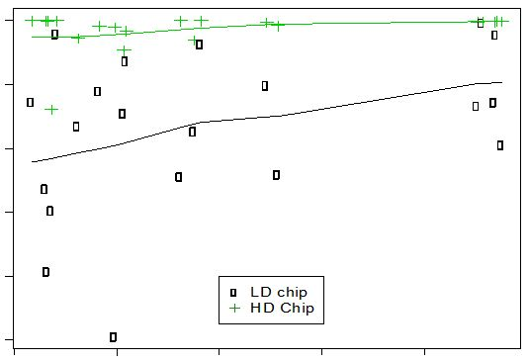
Predicting Genotypes
Choose a target SNP locus
pretend unknown QTL
Use marker SNP within 500kb
Code target & markers 0,1,2
1.0
0.8
0.6
r²
0.4
0.2
Bovine 54k
Bovine 777k
0.0
0.1
0.2
0.3
0.4
0.5
MAF

Slide 72
Opportunities
Can predict additive effects of a QTL locus from additive effects of marker loci
use multiple markers not a single locus
HD better prediction (particularly for low MAF?)
So with enough markers, all variants can be (nearly) explained by regressions on markers
Can dispense with ‘polygenic variance’
will not require pedigree!

